Slide 1
Adaptive Metrics and Performance Analysis Tool for Human-Robot Interaction
Author: Esteban Segarra Martinez
Mentors: Dr. Jeremy Marvel

Slide 2
Overview
Introduction
Background
Objectives
Methodology
Setup
Result
Conclusion and Future Work
Q&A
NIST Engineering Laboratory

Slide 3
Introduction
Collaborative Robotics is an emerging field of robotics where the core concept is improving the social interaction between human and robot.
This is usually known as human-robot interaction (HRI); the interaction between robot and human and the feedback between each other
NIST is creating standards that can quantify the user experience between human and robot.
NIST Engineering Laboratory

Slide 4
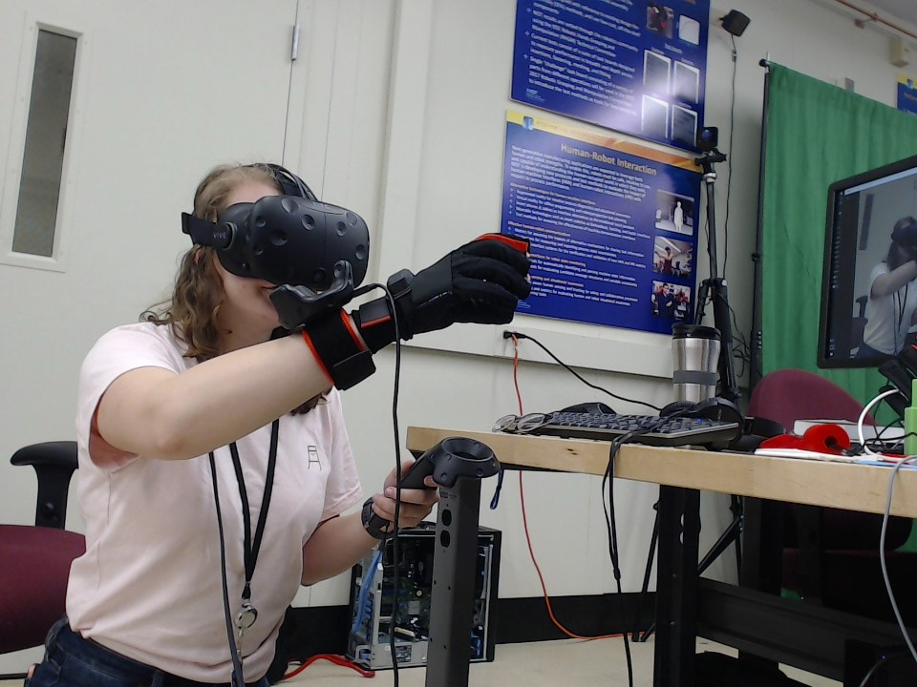
Background
The quality of HRI depends on the effectivity of human-machine interfaces (HMI) to provide reliable information to the operator
HMI is used by an operator for control and feedback on a robot system and varies widely in operation and appearance
HRI is important to cut down on training costs, improve factory floor remodeling times, and reduce the amount of practice time while utilizing a robot’s HMI
Figure ? – Example of a HMI with alternate design
NIST Engineering Laboratory

Slide 5
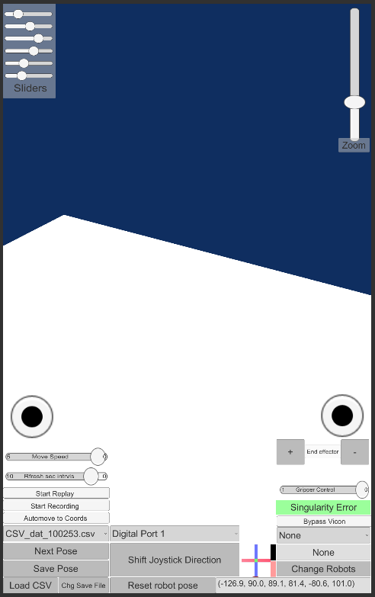
Objective
To improve the readability of HMI, they have to be designed with coherent design, allow the user to use the device in a familiar manner to other similar devices
If the interface is too busy, too overwhelming, or too chaotic, the user will lose interest, be confused by the design and not be able to use the robot effectively
Effective design includes a balanced amount of information; allowing the operator to control the robot and decide the course of action depending on the situational awareness of the problem
Figure ? – So many buttons!
NIST Engineering Laboratory

Slide 6
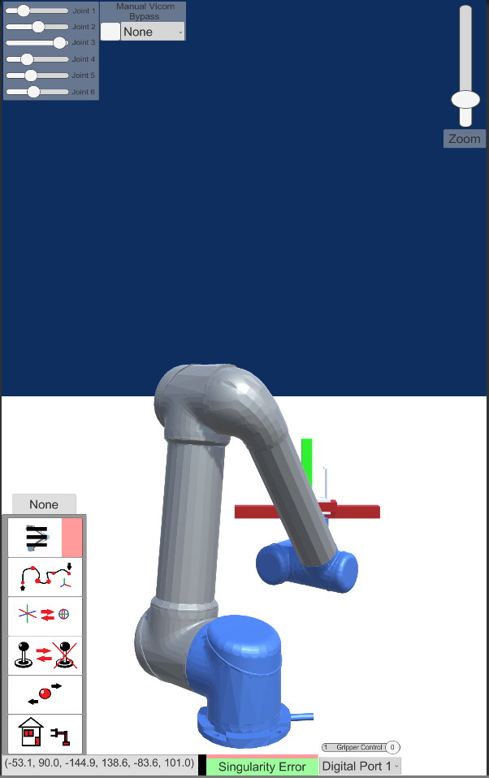
Methodology
To determine good quantification metrics for HMI, different types of interfaces should be designed. These interfaces should allow the user to experience different features of the interface
Researchers can determine what features of control, feedback, and the general layout would work most effectively for users using the interface.
Some metrics used to quantify the experience include effectiveness, efficiency, reaction time, precision, and/or communication time
NIST Engineering Laboratory

Slide 7
Methodology - Continued
There are various contingencies to a good user interface for HRI or HMI; these include but are not limited to the following:
Performance
Utility of mixed initiative
Situational Awareness
Awareness of operator
Safety
These are not all possible categories to quantify HRI or HMI performance but some of the important aspects
NIST Engineering Laboratory

Slide 8


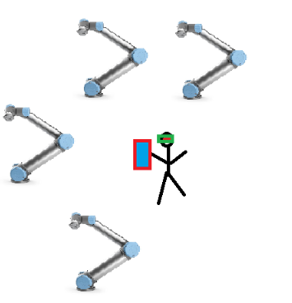
Setup
To test scenarios for UI experience the system should allow researchers to tweak and change the interface to observe for changes
The setup consists of a tablet with a modifiable interface and the inclusion of a motion capture system to track user position
With this relatively simple system, researchers will be able to determine metrics for the system based on feedback from different interfaces and polling different humans testing the system
Figure ? - Control Robots with different interfaces
NIST Engineering Laboratory

Slide 9
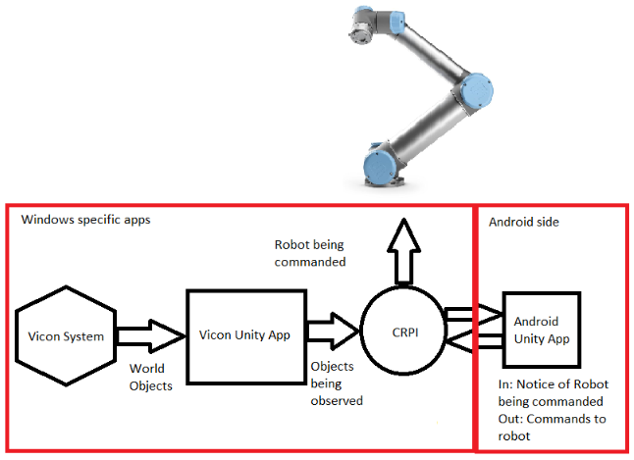
Setup - Continued
The system is divided into several sub-components that allow the design to be portable and flexible for metric studies
Collaborative Robotics Programming Interface (CRPI) allows the program to send commands to the robot from the tablet to the robot
The Vicom relays data from a separate server whereupon a separate Unity instance calculates the position of items and determines what robot is the user looking at
NIST Engineering Laboratory

Slide 10
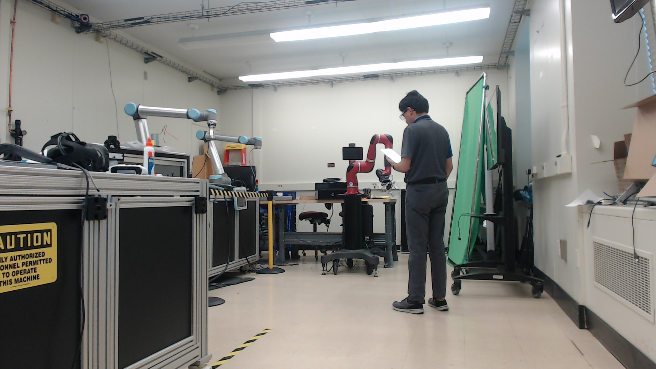
Examples of Live Use of System
NIST Engineering Laboratory

Slide 11
Video Demonstration
NIST Engineering Laboratory

Slide 12
Result
From the preliminary results from the designed user interfaces, we able to setup the system for controlling the robot
Metrics from the user such as the amount of points/effort taken to complete a task were noted and can be taken from the data
Task completion performance is taken into account such as the amount of time that was taken to complete it as well as comparing it against a control task
NIST Engineering Laboratory

Slide 13
Conclusion and Future Work
This study is part of a greater study at NIST for quantifying HRI and HMI systems as being conducted by the Intelligent Systems Division.
These studies will be looking at the use of state-of-the art technologies being utilized such as virtual reality, augmented reality, brain computer interface, or wearable technologies.
Future work will incorporate more different types of technology in the future that can also potentially allow users to control a robot in an effective manner.
NIST will be conducting live trails to experiment on currently developed technology such as this and other tools
NIST Engineering Laboratory

Slide 14
Questions?
Special thanks to:
Jeremy Marvel
Shelly Bagchi
Megan Zimmerman
Project is available on GitHub:
Thank you for NIST SURF 2019!

